Slide 1
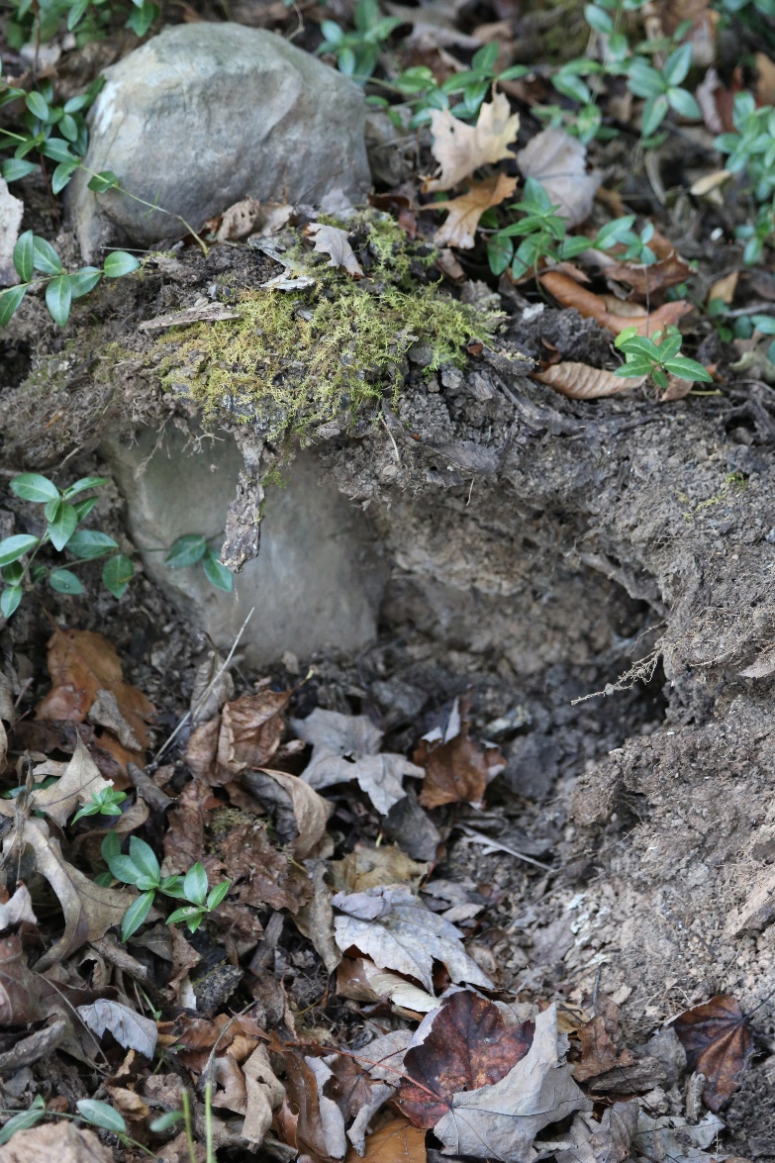

The Rhetoric of Death: Parts 4 and 5
Amy D. Clark, Ph.D.
aclark@Virginia.edu

Slide 3
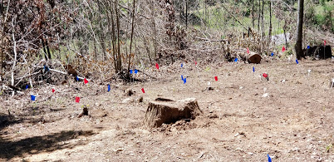
Topography
Lee County is westernmost county in Virginia
7,300 enslaved people there at the onset of Civil War (McKnight, 2006)
Field stones on private, wooded land at the margins of a field
Oral history supports the burial ground of enslaved people

Slide 4
Context: History and Race
African-American minority within cultural minority
Written and oral histories largely exclude the African- American narrative
“Racial innocence myth”-Elizabeth Catte
19th century wealth (and ownership of enslaved people) concentrated among the few
160,000 enslaved people throughout the central Appalachian region

Slide 5
The Space that
“Excites and Troubles”
bell hooks: “narratives of resistance…share an obsession with politics of space” (1995)
Burial ground embodies a “rhetorical memory site for the disenfranchised” (Wright, 2005)
Heterotopia: spaces that embody “crisis” and “deviation” (Foucault, 1984)
Burial ground for enslaved were relegated to hidden spaces-removed from consciousness
“Material site” (place) and “creation of practices” (spaces) (Wright)
19th century: a place of “mourning, remembrance, and continuation” (Rainville)
21st century: a cultural place for the living that inverts or “excites and “troubles” the conscience (Foucault, Wright)

Slide 6
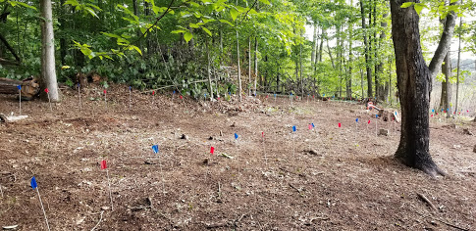
Methodology: Material Culture
The study of signs via artifacts
Poststructuralist approach: considering context in space and artifact creation, particularly when issues of power frame the creation
STEPS IN APPROACH (Prown, 2008)
Analysis of site’s content (artifact, dimensions, materials)
Process of deduction about what the site is communicating
Use of “allied disciplines” to investigate and speculate
-Consulted with archaeologists, physicist, textile expert, historians over the course of this research

Slide 7
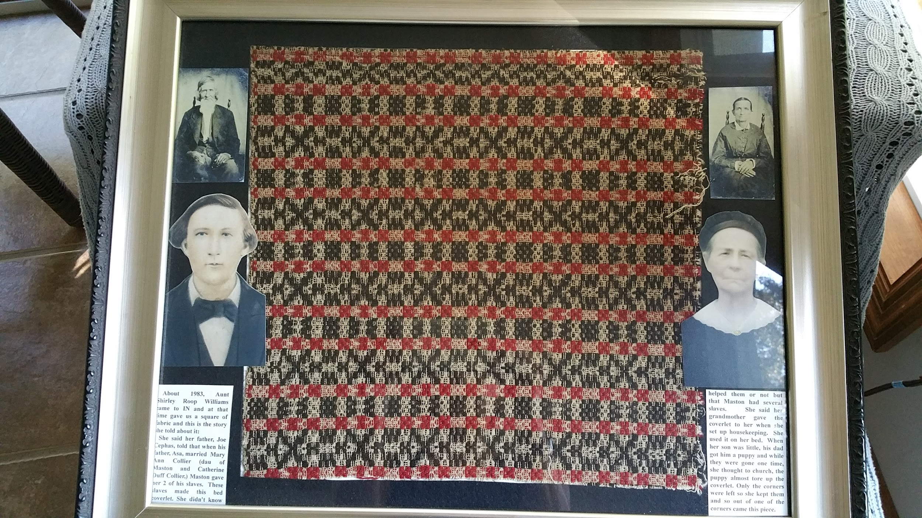
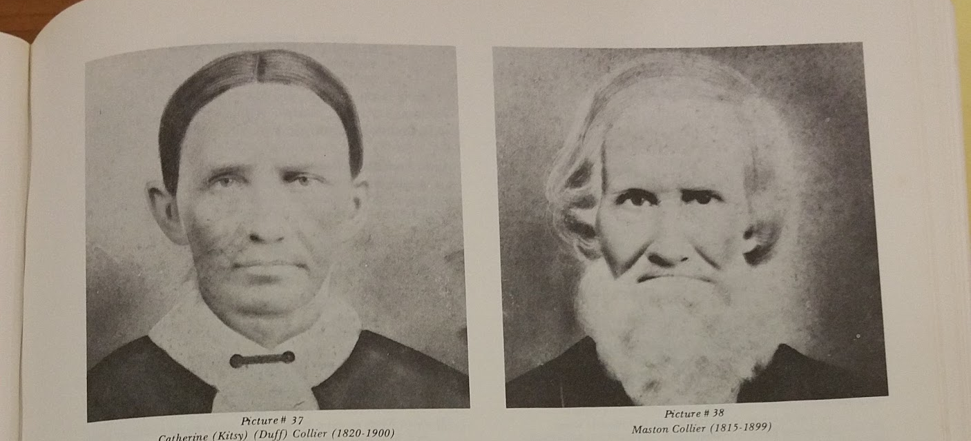
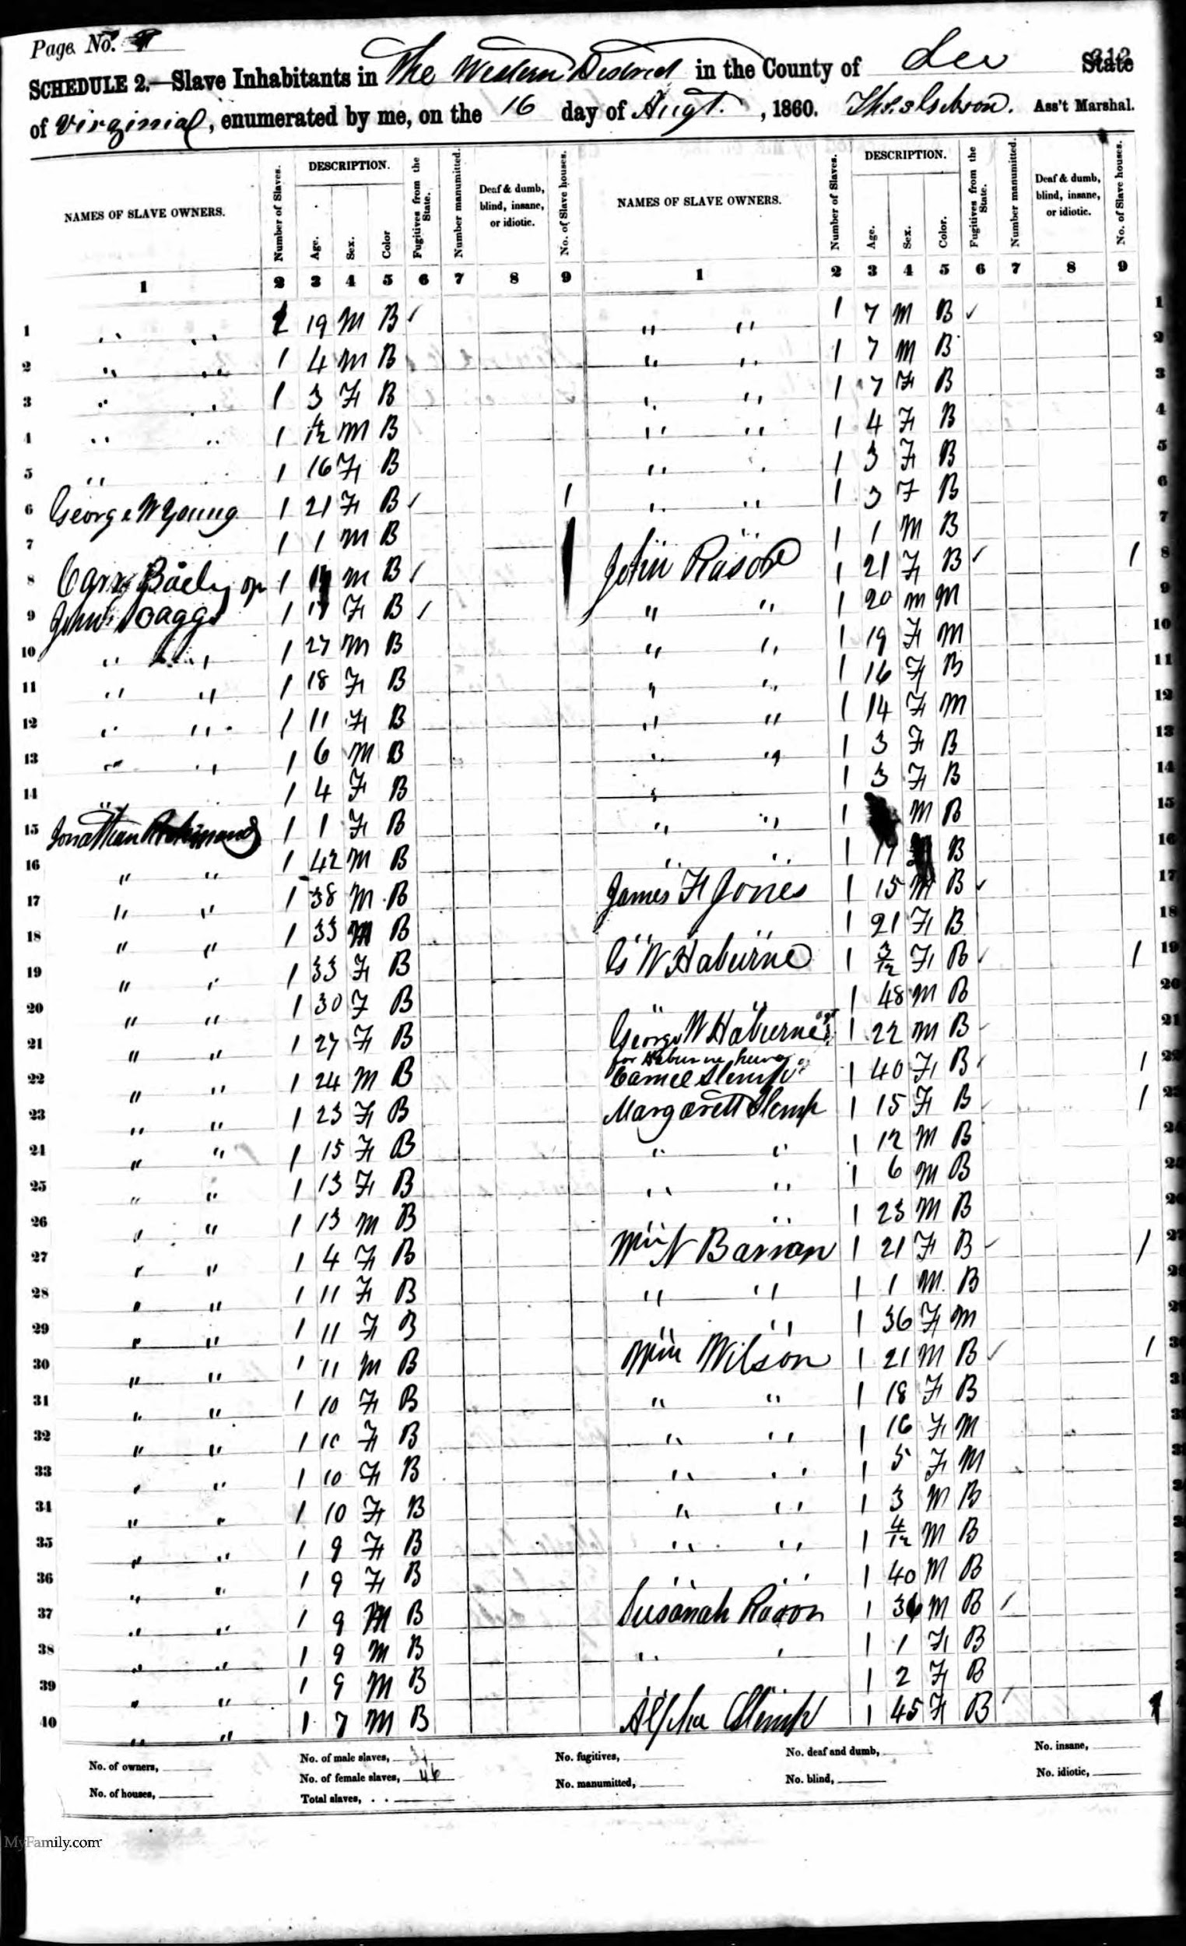
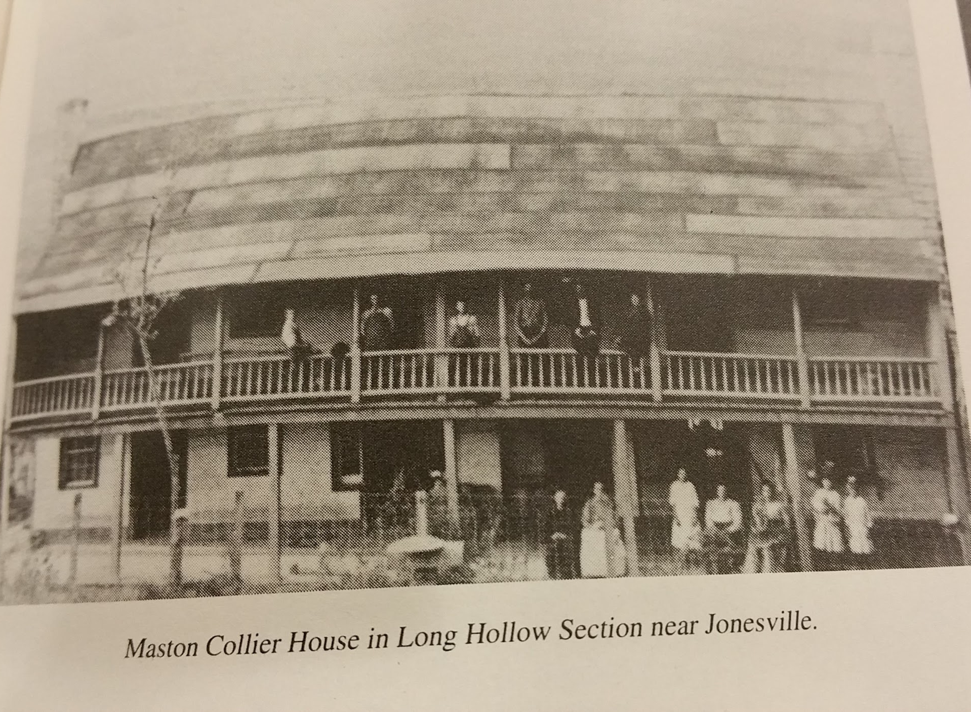
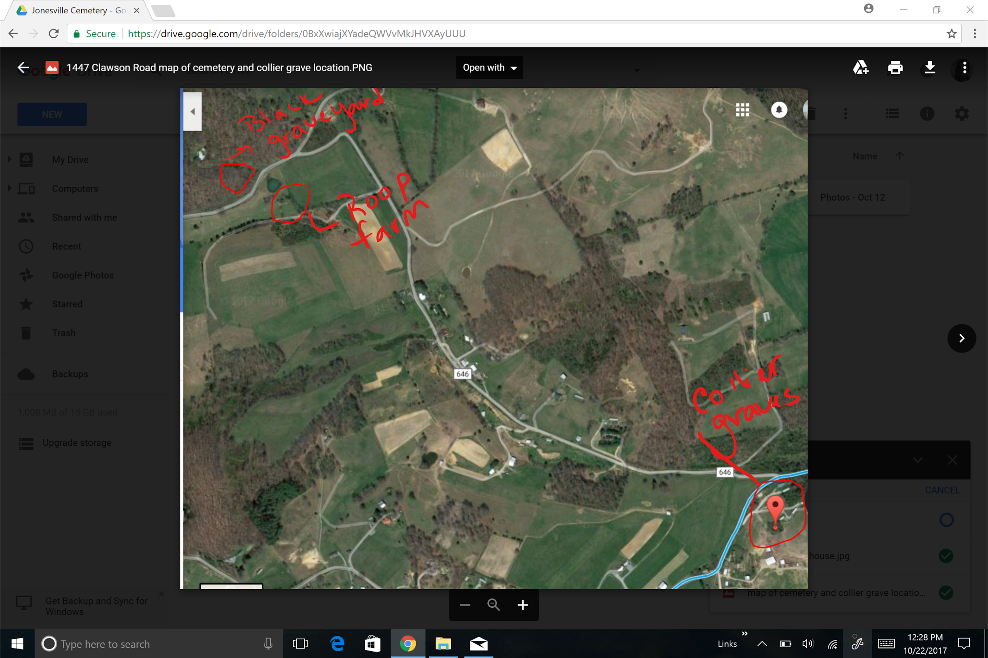
Connecting Oral History to Artifacts

Slide 8
Site Profile Based on Rainville’s 2014 Studies
Site is segregated from traditional burial sites like churchyards and family cemeteries on the margins of crop land
It is removed from the owners’ home by several hundred yards
It is located on a hill in the woods

Slide 9
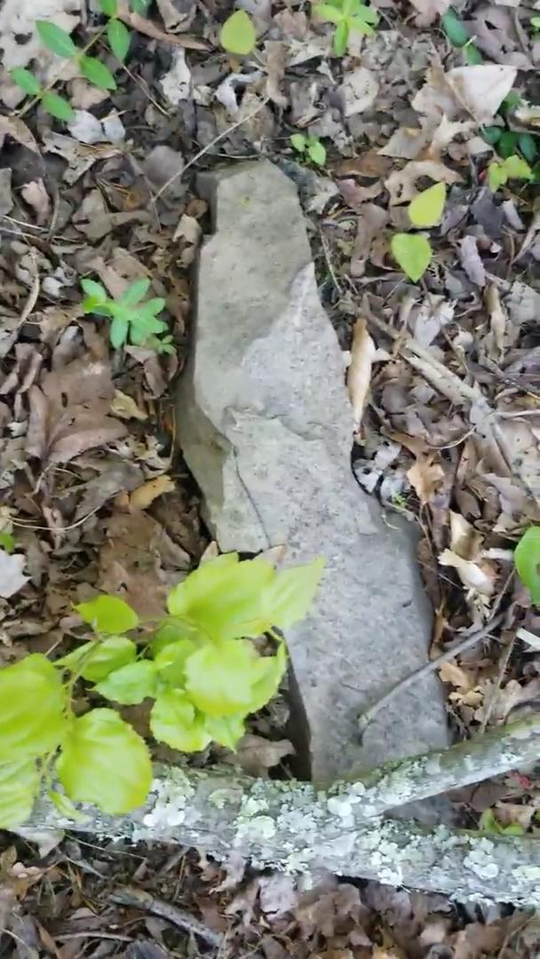

Slide 10
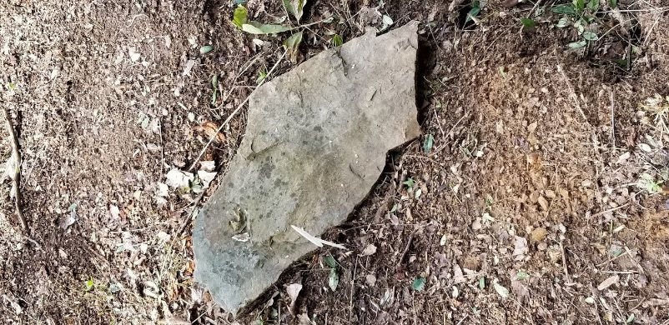
Coding Using the Semiotic Approach
Symbols or codes govern how we make meaning
Semiotic relationships
Codes that enable people to process death and grief:
  -the color black
  -iconography and epitaph on gravestones
  -rituals that govern the process of death and grief
  Codes are situated in time and space of creation, but
  Codes may be interpreted in differing contexts of time and space (Jim Crow era versus the era of #blacklivesmatter)
  A contextual understanding of the area and its history is necessary to “read” the material culture that expects social interaction

Slide 11
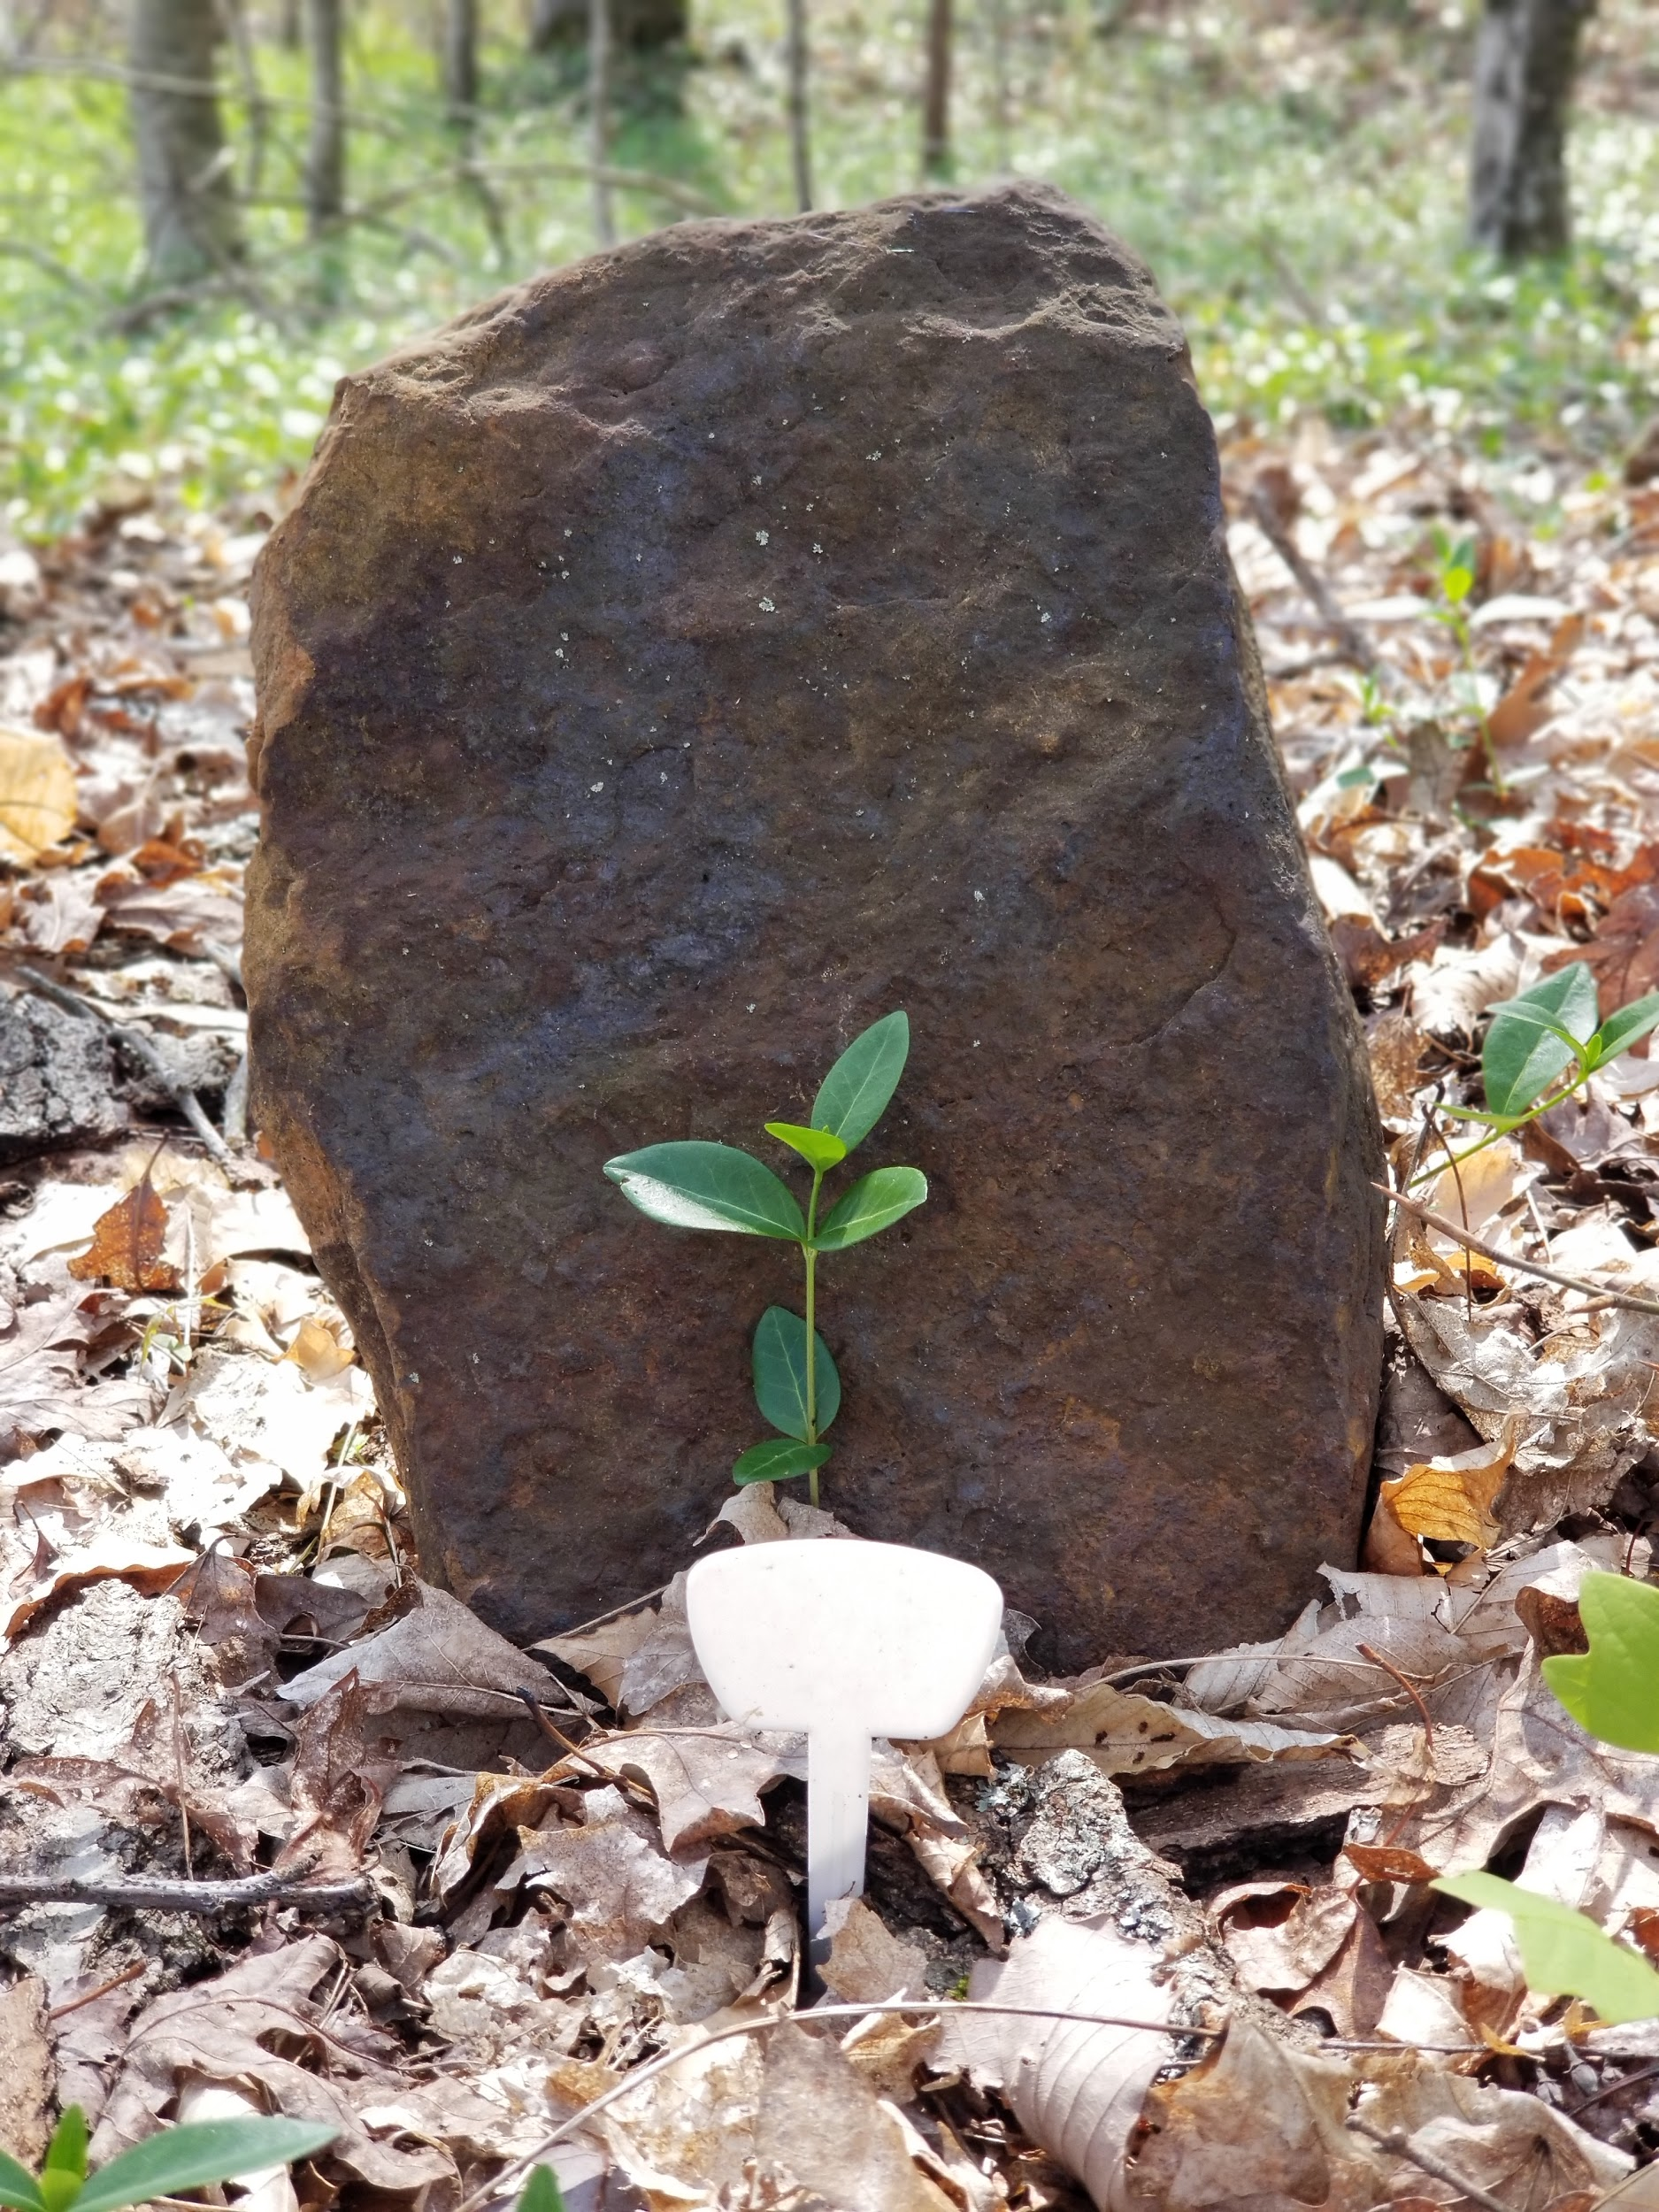
Morphology
Fieldstones (limestone, sandstone, soapstone)
Lack of text (illiteracy)
Shape
Obelisk: enslaved African Americans using stone stele resembling Egyptian obelisks before whites (Rainville, 2014)
Shape | Number of Fieldstones
Square (<6 inches) | 9
Square (>6 inches) | 2
Tapered (mound) (< 6 inches) | 3
Tapered (mound) (> 6 inches) | 4
Tapered (pyramid) (< 6 inches) | 2
Tapered (pyramid) (> 6 inches) | 10
 | N=30

Slide 12
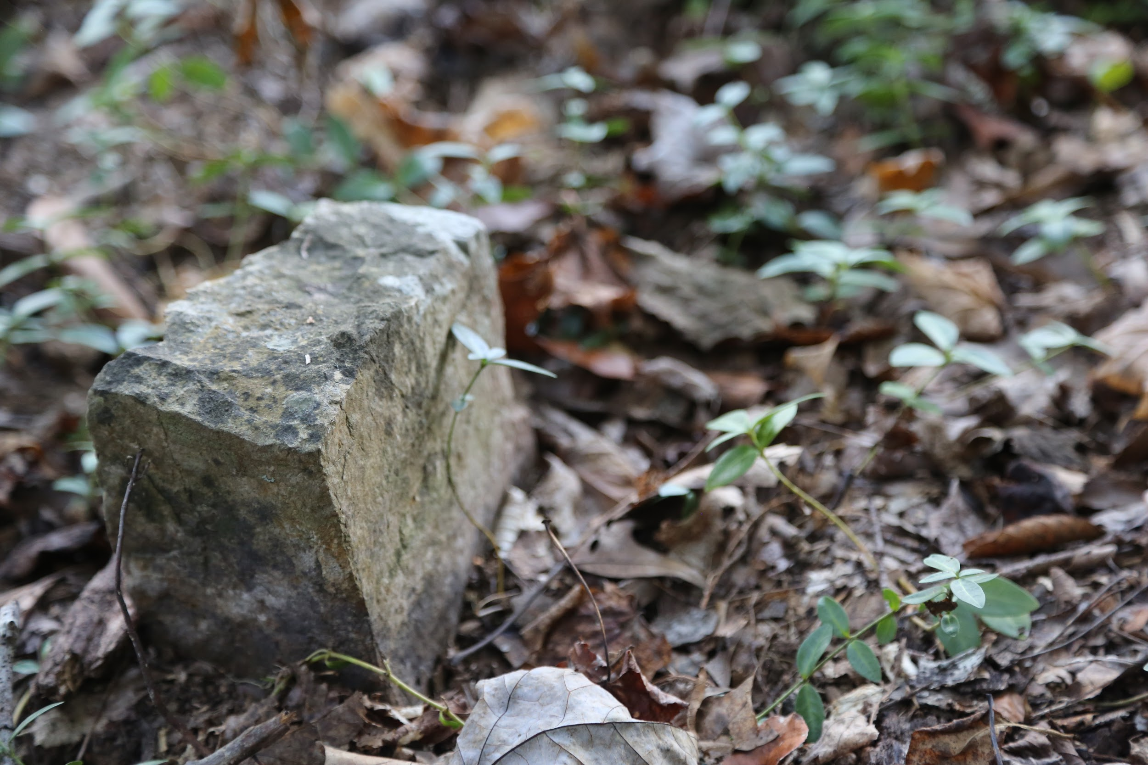
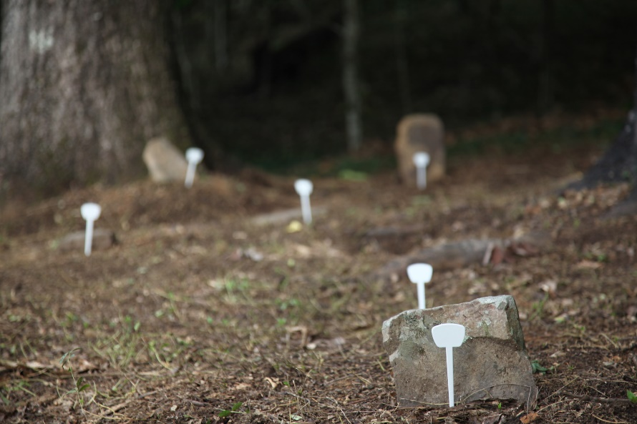
Size
Public cemeteries: size indexes wealth as well as age
This site: size indexes age (confirmed with GPR reading of length of remains)
Order and Direction
Encodes messages about the afterlife
Semiotic relationship between placement and direction
Rows facing east: two symbolic possibilities
  1. Christian burial custom
  2. African custom: deceased rested facing Africa (Rainville, 2014)

Slide 13
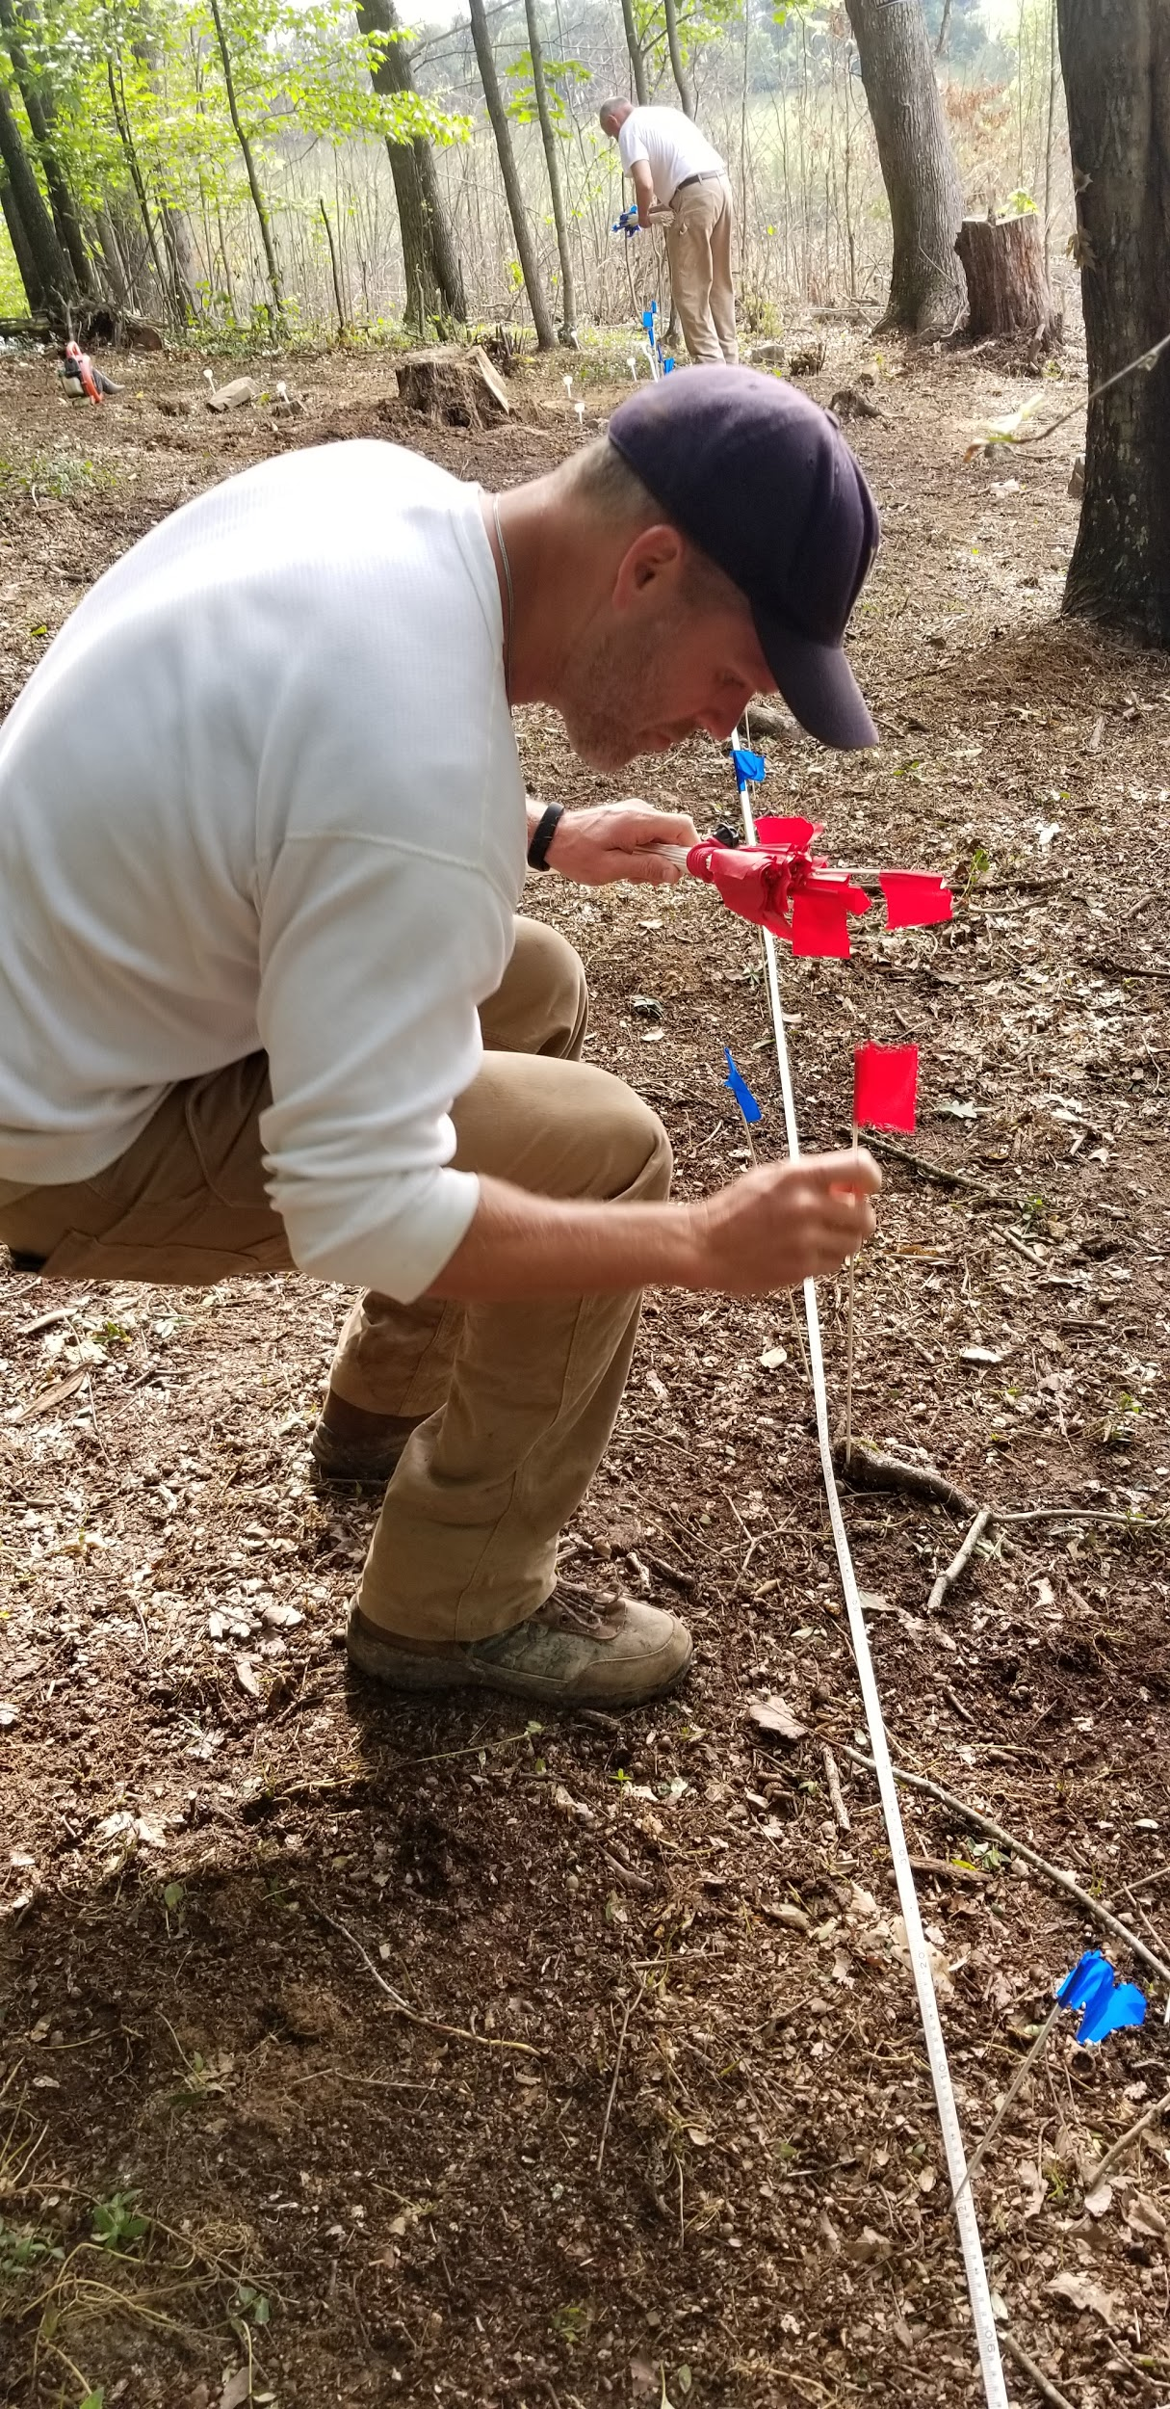
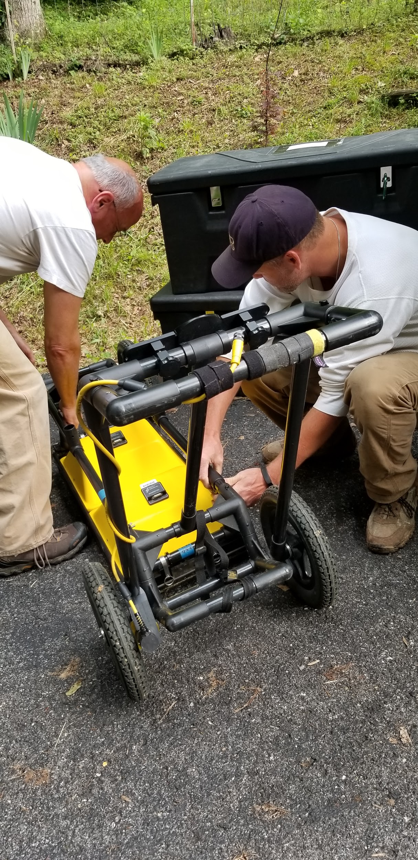
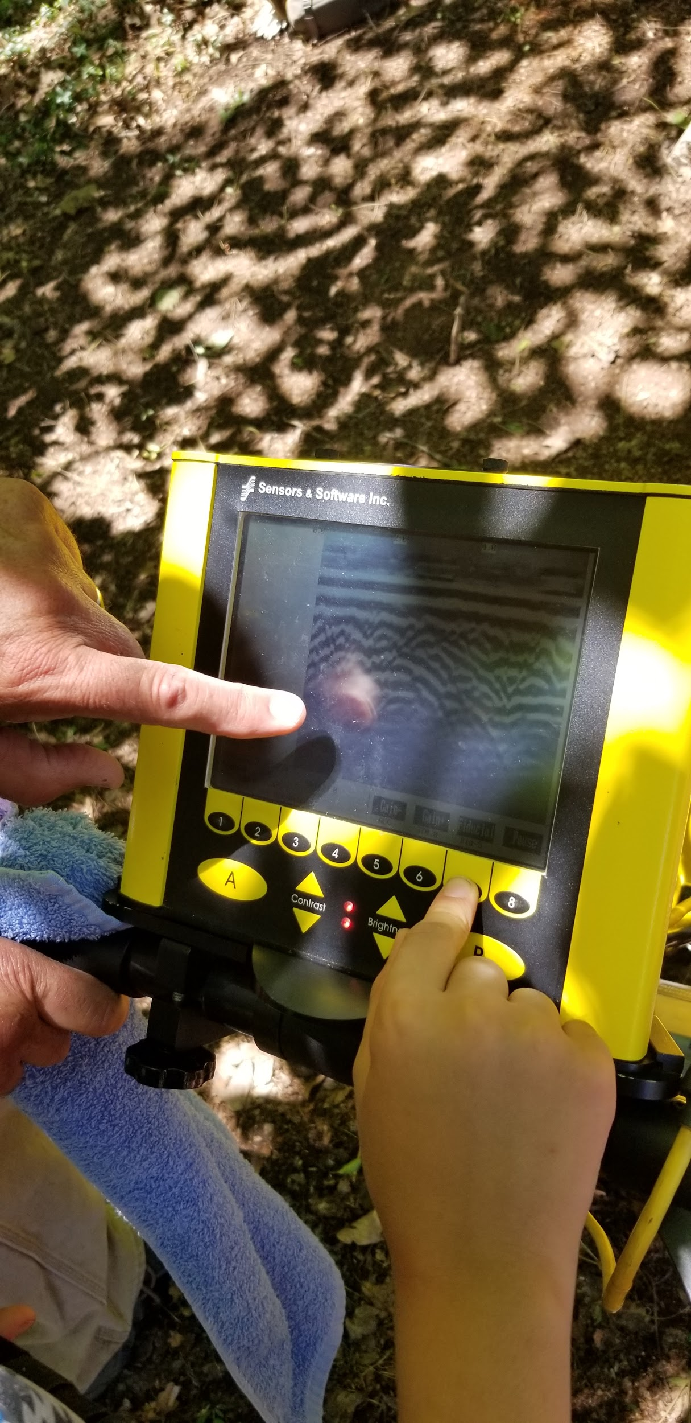
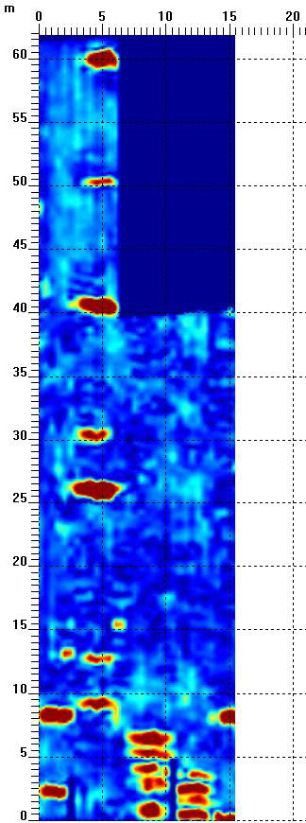
Digital Imaging

Slide 14
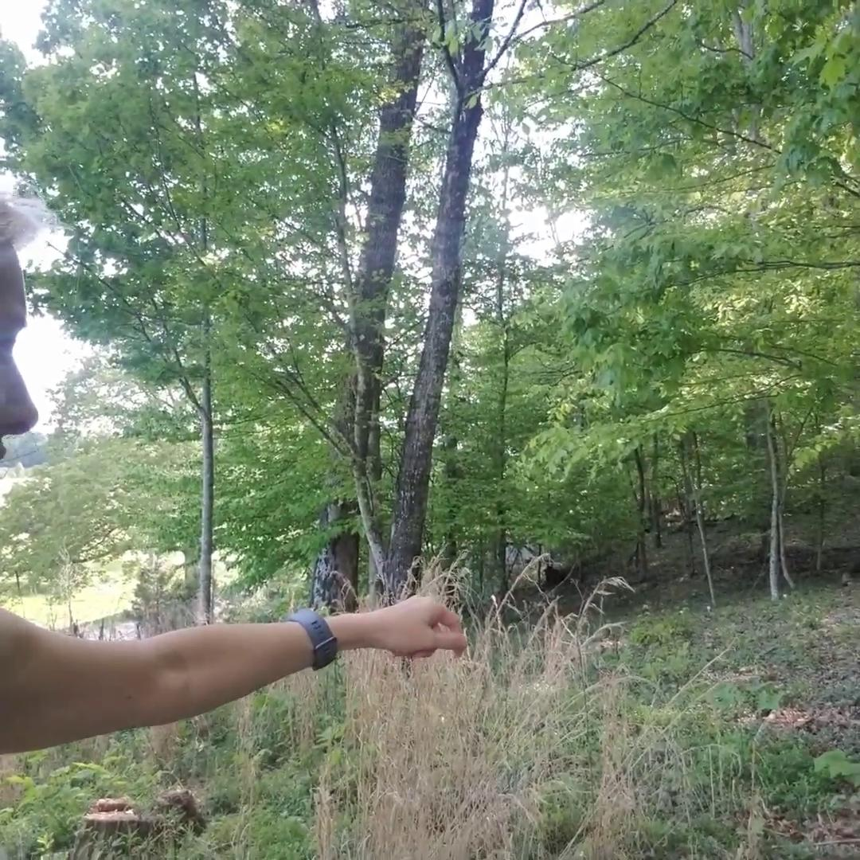
At the site, where I
discuss the process of mapping and reading the order of burials under the soil

Slide 15
Digital Imaging
Many stones uprooted by tree roots
GPR confirmed order and direction of burials
Abstract is given visual form
Allows “conceptual world to enter perceptual one” and “elongate the indexical link” (Wolf, 1999.)
1. Both adults and children buried there
2. Bodies ordered east to west
3. Purposeful clustering-family?
Discussion and Implications
Communicating for survival, even in death
Creates an everlasting cultural space signifying memory, family, and a history that may predate Christianity

Slide 16
References
Catte, E. (2018). What you are getting wrong about Appalachia. Cleveland: Belt Publishing.
Foucault, M. (1967). Des espace autres [Of other spaces: Utopias and
Heterotopias]. Architecture/Mouvement/Continuite, 16(1), 46-49.
Handa, C. (Ed.). (2004). Visual rhetoric in a digital world. New York: Bedford St. Martin’s.
hooks, b. (1995). Art on my mind: Visual politics. New York: The New Press.
Mayes, T. (2014). Why do old places matter: Individual identity. Retrieved from: https://goo.gl/8LFPAz
McKnight, B. (2006). Contested borderland: the Civil War in Appalachian Kentucky andVirginia. Lexington: University Press of Kentucky.
Prown. J.D. (2008). Mind in matter: An introduction to material culture theory and method.Winturther Portofolio 17(1), 1-19.
Raboteau, E. (2013) Searching for Zion. New York: Atlantic Monthly.

Slide 17
References
Rainville, L. (2016). Hidden history: African American cemeteries in central Virginia.
Charlottesville: University of Virginia.
Wolf, M. (1999). Collecting visible evidence. Ed. Jane M. Gaines & Michael Renov.
Minneapolis: U. of Minnesota Press. P. 274-201.
Wright, E. (2005). Rhetorical spaces in memorial places: The cemetery as a rhetorical memory place/space. Rhetoric Society Quarterly. 35(4), 51-81.
Amy D. Clark
aclark@Virginia.edu

