Slide 1

THE RHETORIC OF DEATH: Parts II and III
Amy Clark, PhD
Chair, Communication Studies
Founding Co-Director, Center for Appalachian Studies
The University of Virginia’s College at Wise

Slide 2
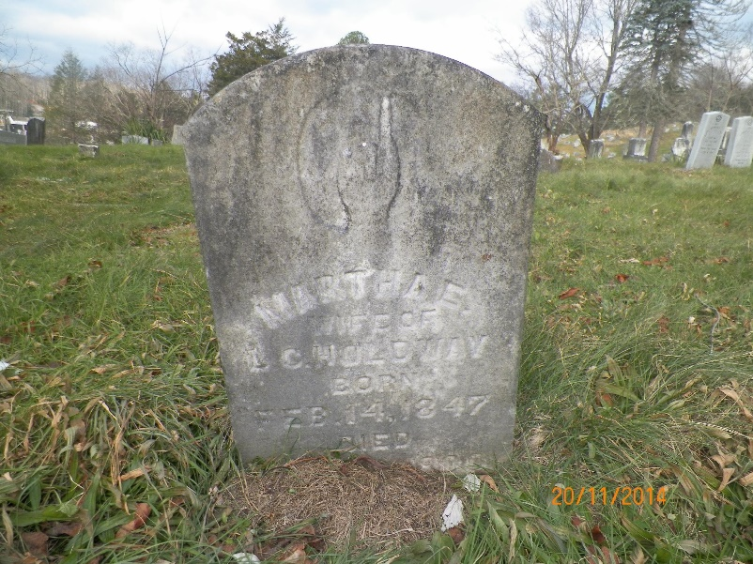
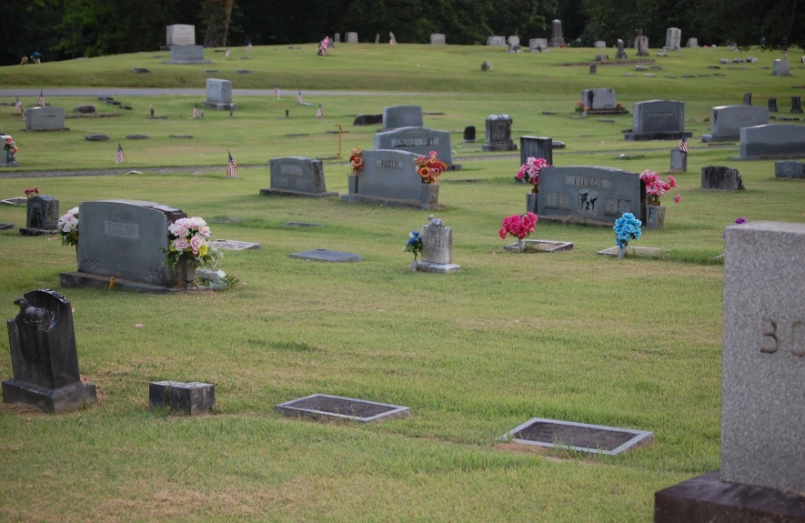
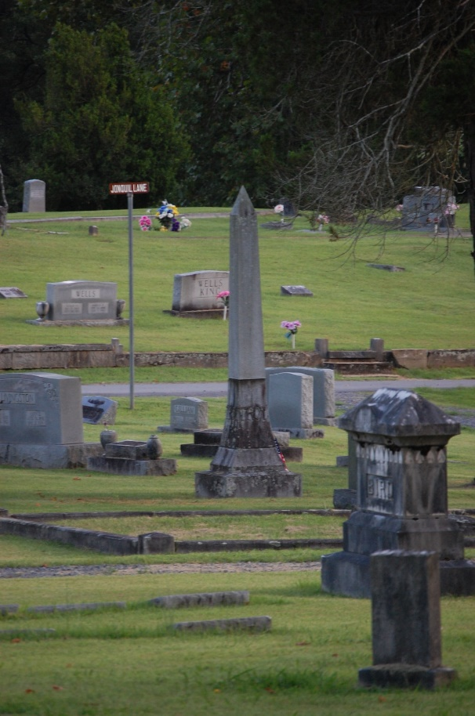
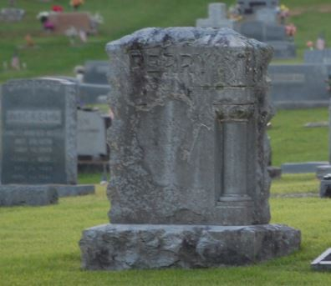
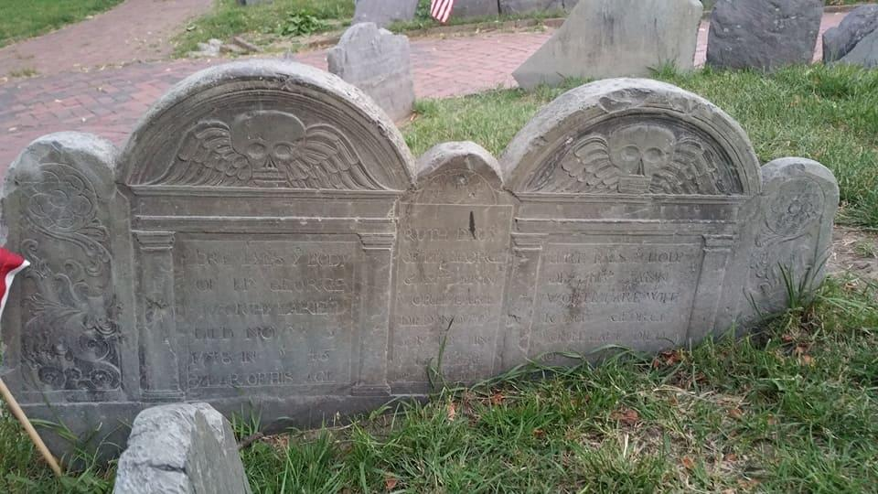
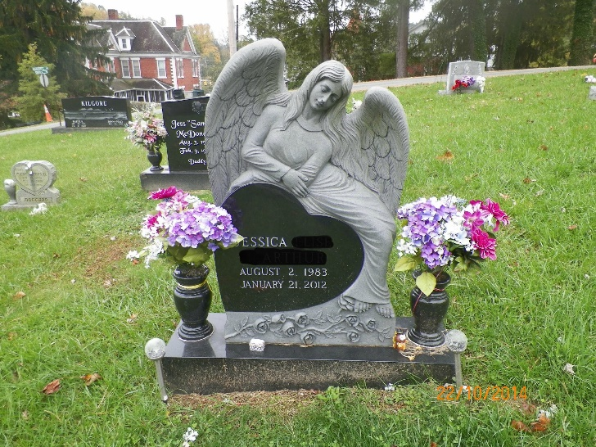
THE GRAVESTONE AS RHETORICAL ARTIFACT

Slide 3
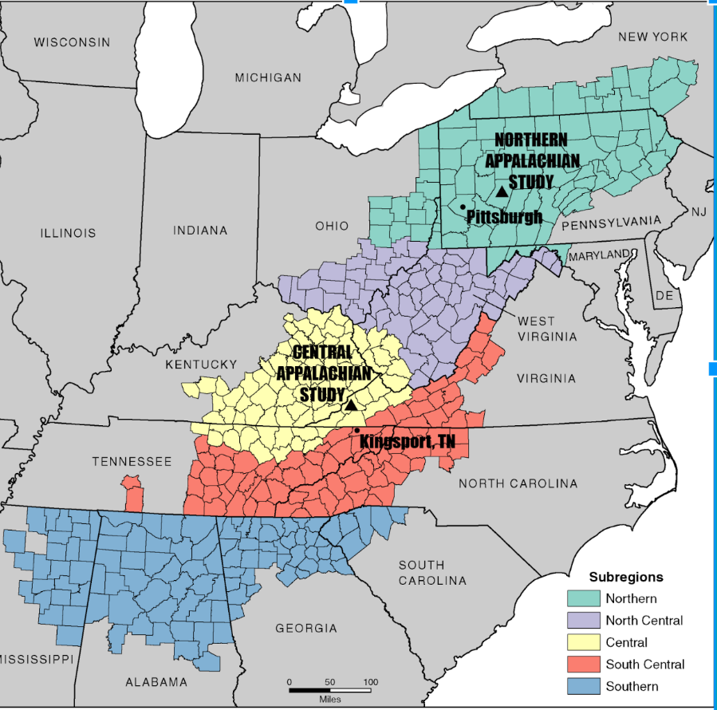

Slide 4
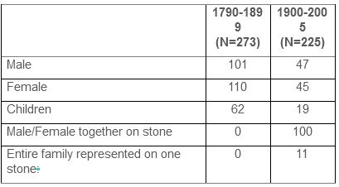
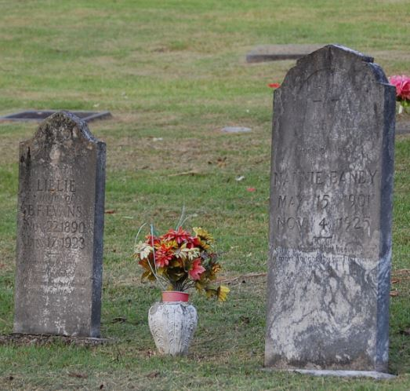
NORTHERN APPALACHIA SITE
Analyzed 498 stones
Mortality patterns
Names

Slide 5
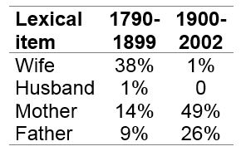
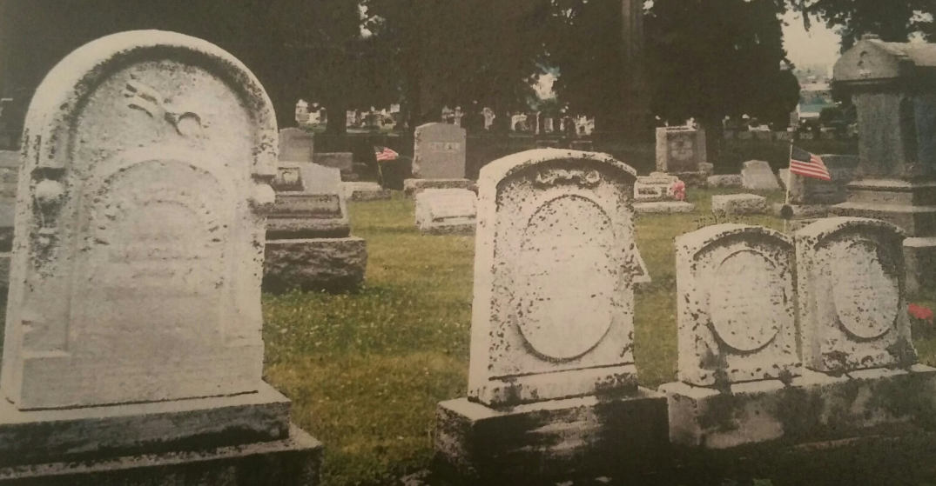
NA STUDY
Familial representation
Occupation

Slide 6
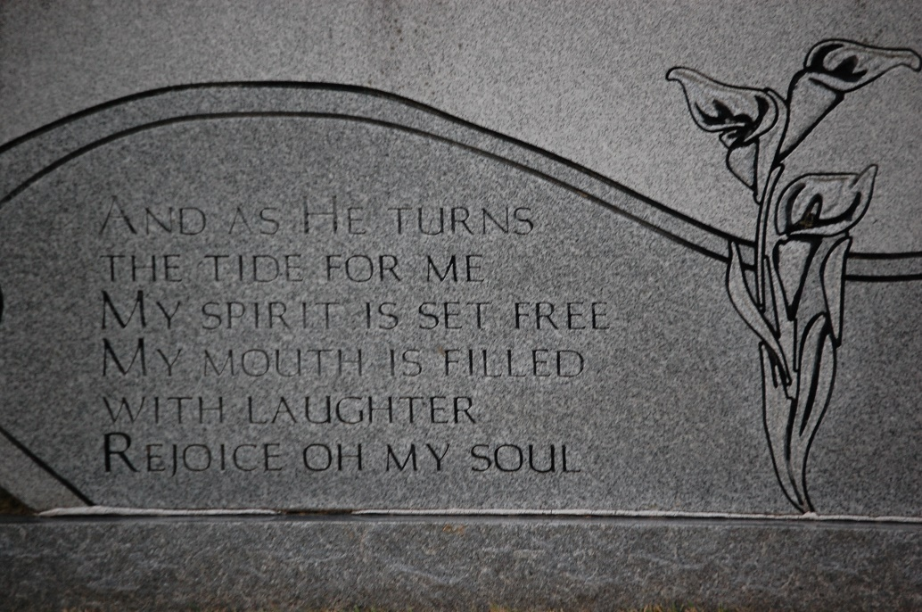
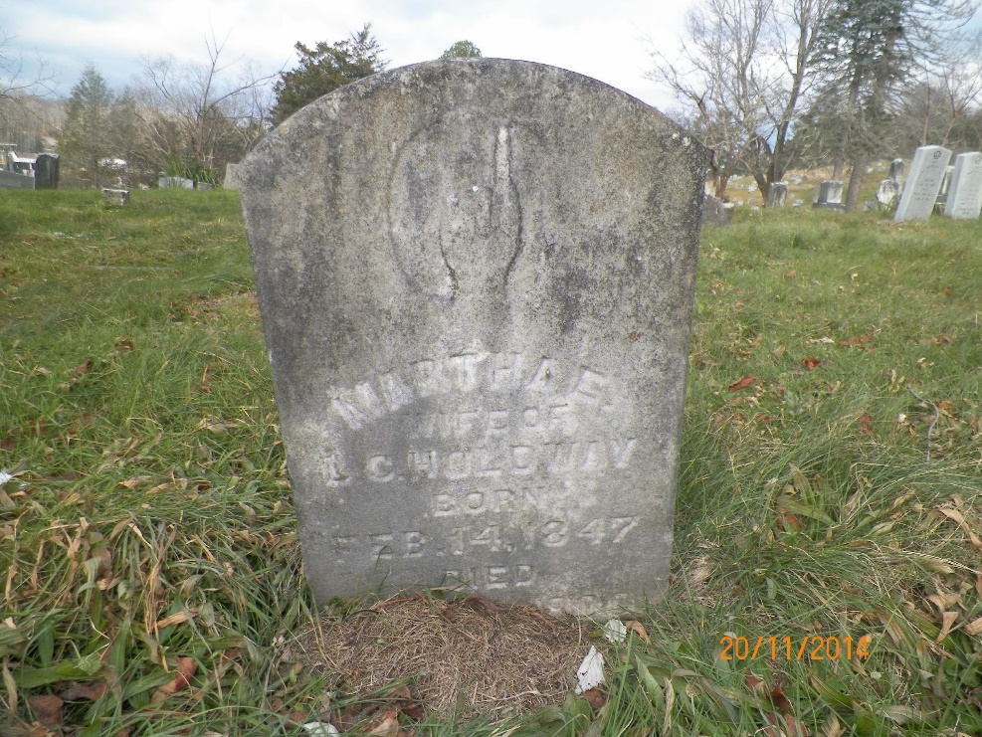
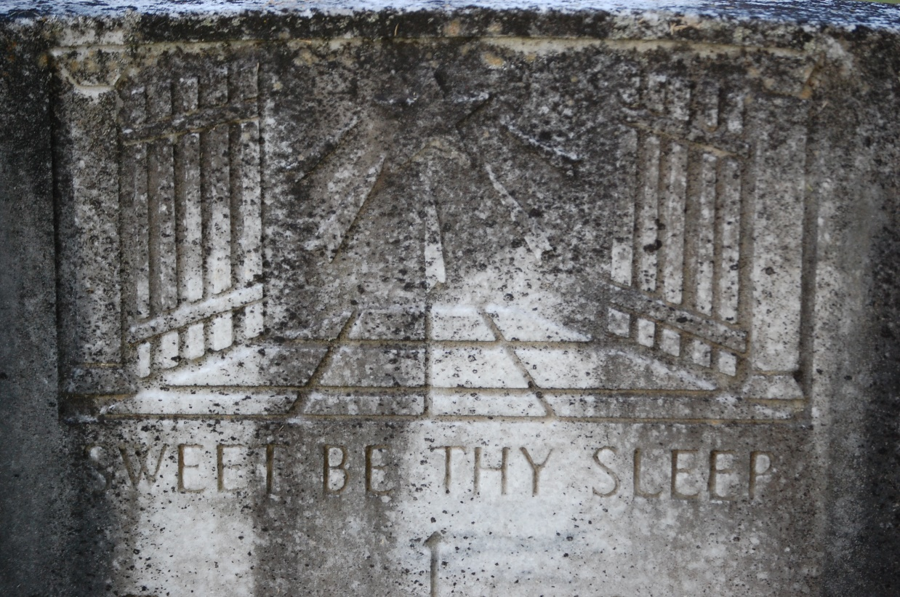
EPITAPH AND ICONOGRAPHY

Slide 7
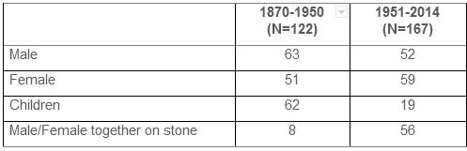
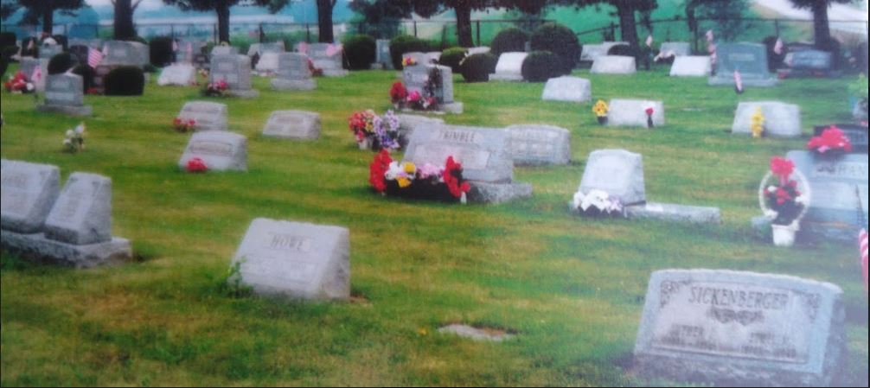
THE CENTRAL APPALACHIAN SITE
Mortality patterns
Familial roles
Occupational affiliation
Epitaph/iconography

Slide 8
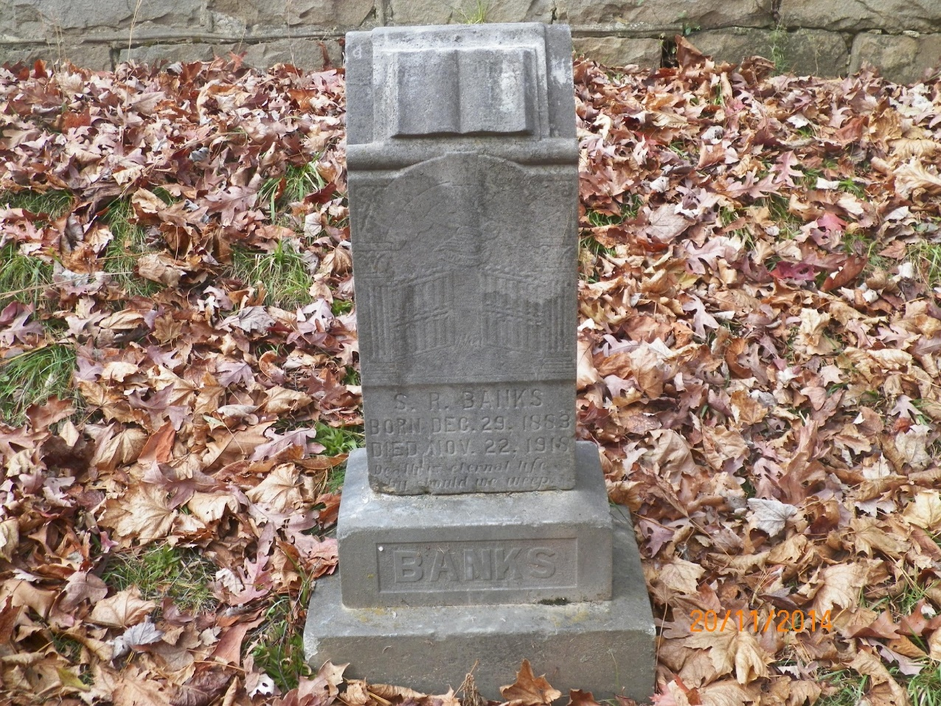

Pulpit
Die-in-Socket

Slide 9
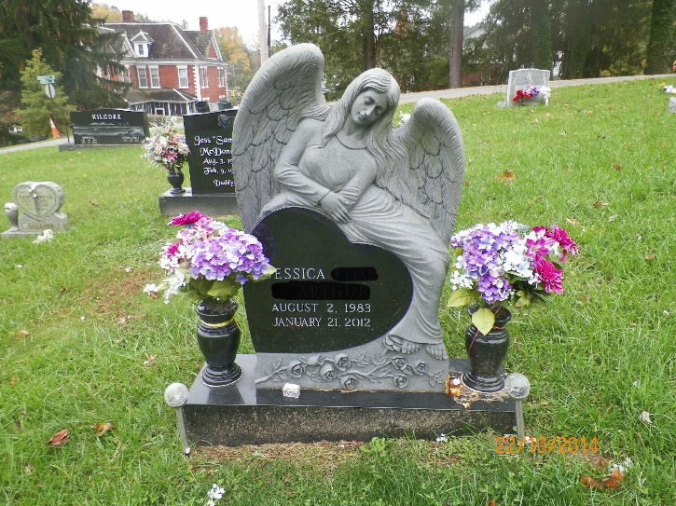
SUMMARY
Symbolic constructs align with trends in different time periods
Architecture trends toward a standard stone, then back to differentiation
Iconography and epitaphs correlate with religious patterns in Appalachia
Women have more agency in how they are represented
Titles of “mother” and “wife” continue to be privileged

Slide 10
Clark, A., Johnson, A., & Mathews, D. (2017). “The Gendered Language of Gravestones: A Comparison of Northern and Central Appalachian Cemeteries.” In (Brunn, S., Gilbreath, D. & Kehrhin R., Eds.) A Changing World Language Map. NYC: Springer, 2020.

