Slide 1

This is how they see mE
Day 5
Socio-Economic
Richard T. Craig, PhD
George Mason University

Slide 2
Social-Class…
One of the most fundamental dimensions of social organization…
  Organization of individuals into groups
  Arranged hierarchaly
Marx
  Based in Marxism…social class determined by individuals relationship to power and production
    Does individual posses the power to produce?

Slide 3
Social-Class
Weber 3 elements of social class
  Economic position
  Social status or prestige
  Power
    Some scholars also include
      Education
      Occupation
      Income
      Wealth
Classes often recognized in contemporary U.S.
  Lower Class
  Working Class
  Middle Class
  Upper-middle Class
  Upper Class

Slide 4
Living the “American Dream” via Media
Paulson and O’Guinn
  Nearly half Americans believe they are middle class
    Mass media has been said to lead to misperceptions about American’s self-perception of belonging to the middle class.
      Media blurs the lines between social classes
What is the “American Dream”
  Life should be better and filled with opportunity for everyone, despite social class!
    3 Interrelated ideas constructing the American Dream
      Opportunity
      Meritocracy
      Upward mobility
Most Americans believe that opportunity is “widely available” (Paulson and O’Guinn, 2018)
  Hard work and talent gets you ahead!

Slide 5
Value of Capital in Social Class
Bourdieu’s conception (O’Sullivan, 2016)
  Economic capital (money and property)
  Cultural Capital (cultural goods and services including educational credentials)
  Social capital (acquaintances and networks)
  Symbolic capital (legitimation)

Slide 6
Low-income/Impoverished Class
Bunds & Newman (2015)
  Media allows audiences to consume the “horrors” of poverty without having to engage in the material realities of poverty.
    Those who are impoverished (a la the “bum” in Bunds and Newman’s study) become the “other”
      The Impoverished other is
        Undeserving
        Pathological
        Irresponsible

Slide 7
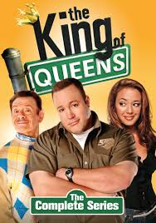

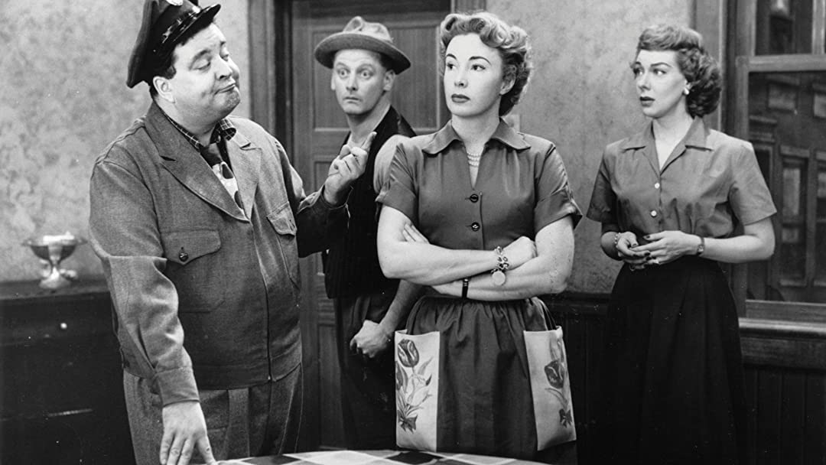
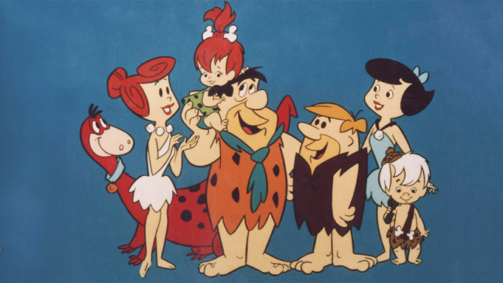
Working Class
Working Class Media Traits (stereotypes) (Behm-Marowitz, 2018)
  Lacking intelligence
  Lacking in taste
  Lacking in parenting skills
    Men
      Lazy
      Unintelligent
      Buffoons
    Women
      Depicted by success in domestic sphere
  Unable to take responsibility for their lives

Slide 8
Upper-Class
Depicted more favorably than working class
  Better parenting
  Better taste
  Higher intelligence

Slide 9
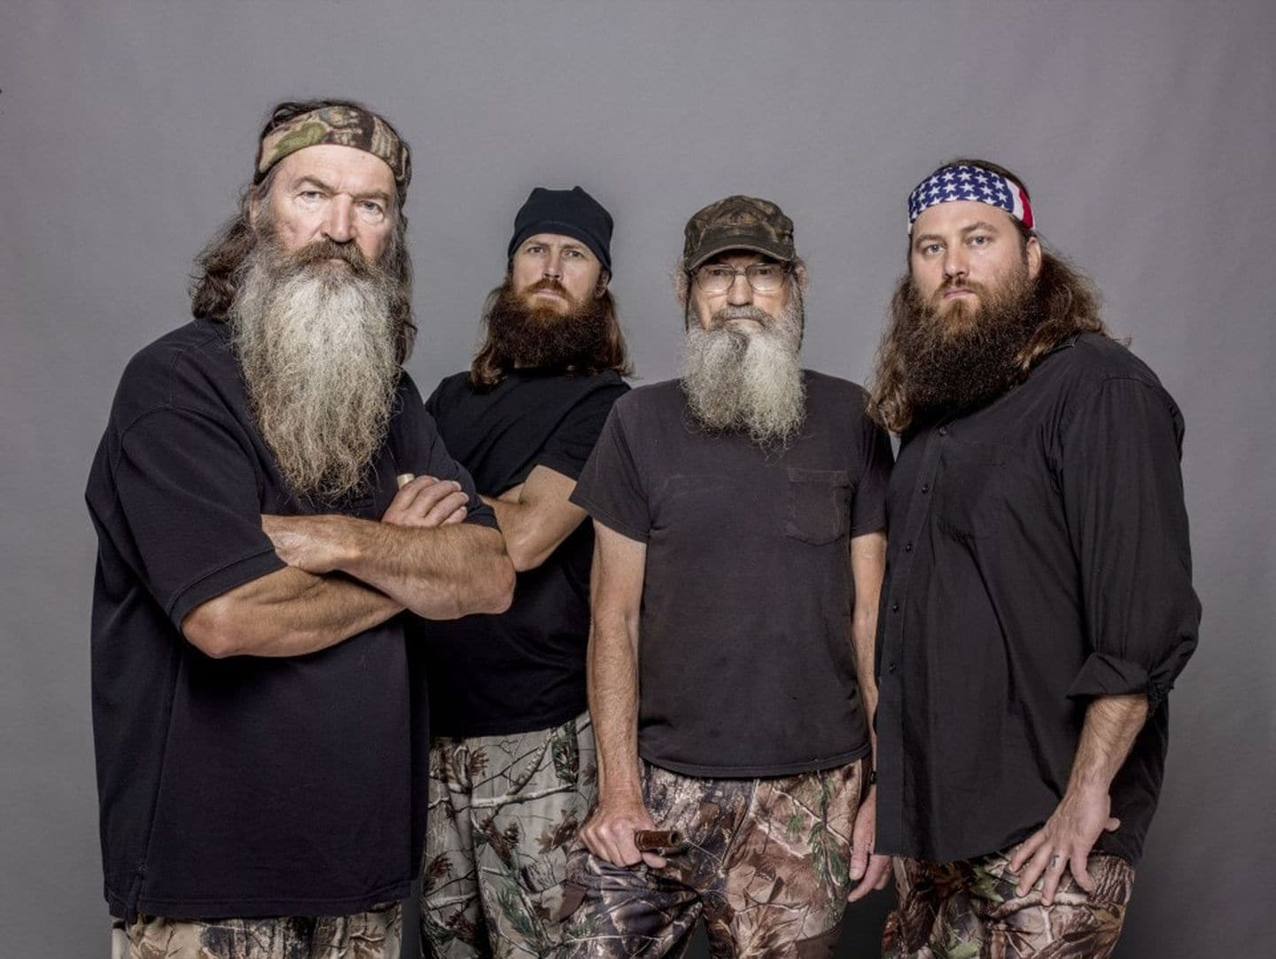

Performing Class
Grindstaff (2002)---from Lee and Moscowitz (Gender Race and Class Reader)
  Class, especially in the context of television, is also a performance, a social script involving, among other things, language use, mannerisms, and dress
  Wood and Skeggs
    Perfomatives are unconscious repeated gendered and classed enactments, while performances are full-blown conscious actions. What we often see on reality television is the performative made explicit.

Slide 10
Authenticity…

Slide 11
References
Behm-Morawitz, E., Miller, B. M., & Lewallen, J. (2018). A Model for Quantitatively Analyzing Representations of Social Class in Screen Media. Communication Research Reports, 35(3), 210–221. https://doi-org.mutex.gmu.edu/10.1080/08824096.2018.1428544
Bunds, K. S., Newman, J. I., & Giardina, M. D. (2015). The Spectacle of Disposability: Bumfights, Commodity Abjection, and the Politics of Homelessness. Critical Studies in Media Communication, 32(4), 272–286. https://doi-org.mutex.gmu.edu/10.1080/15295036.2014.944928
Lee, M. J., & Moscowitz, L. (2013). The “Rich Bitch”: Class and Gender on the Real Housewives of New York City. Feminist Media Studies, 13(1), 64–82. https://doi-org.mutex.gmu.edu/10.1080/14680777.2011.647971
O’Sullivan, S. E. M. (2016). Playing “Redneck”: White Masculinity and Working-Class Performance on Duck Dynasty. Journal of Popular Culture, 49(2), 367–384. https://doi-org.mutex.gmu.edu/10.1111/jpcu.12403
Paulson, E. L., & O, G. T. C. (2018). Marketing Social Class and Ideology in Post-World-War-Two American Print Advertising. Journal of Macromarketing, 38(1), 7–28. https://doi-org.mutex.gmu.edu/10.1177/0276146717733788

