Slide 1

Is this how they see me
Masses, Messages and Meanings
Richard T. Craig
George Mason University

Slide 2
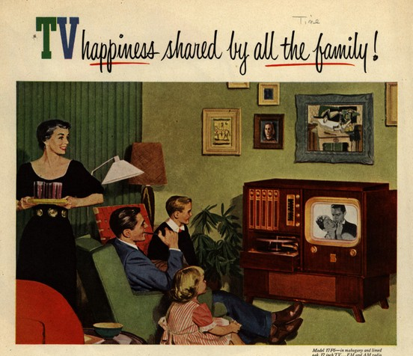
The Ubiquity of the Media Environment
Our lives are saturated with media technologies and images.

Slide 3
The Mass Society Questions:
What happened to American
Culture and Politics? (1865-1939)
How did we get to the point where the public—or rather, the “masses”— can have their hearts and minds shaped by mass mediated propaganda?
How did we get to the point where the new, powerful means of mass communication have become polluted with mindless “mass culture”?
The Answer: The Transition from
Rural Community to Urban Mass Society.

Slide 4
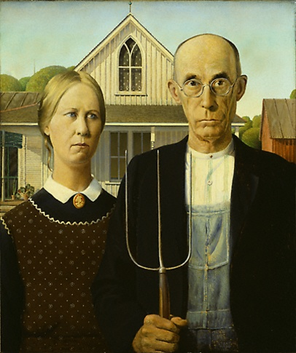
Rural Community
(Gemeinschaft)
Social stability.
Strong collective values.
Reliance on traditional authorities.
Folk culture: organic, participatory.

Slide 5
Urban Mass Society
(Gesellschaft)
Atomized individuals without social ties pour into city.
Cut off from traditions, values, folk customs.
The new urban masses:
isolated, anonymous individuals crammed together in the new industrial city.

Slide 6

Semiotics:
The Study of Signs (Symbols)
Signs – are things (objects, words, images) that have a meaning.
How do roses—a physical object—communicate meanings (such as…)?

Slide 7
Sign = Signifier + Signified
Signified → The meaning itself.
    The abstract “concept” carried by the signifier.
Signifier → The physical carrier of meaning.
    Word (sound), Word (written), Image, Object.

Slide 8

Sign = Signifier + Signified
Signifier + Signified = (Sign)
+ Love/Passion = (Roses=I Love You)
Writing on Card + Love/Passion = (Words = I Love You)
(“I Love You”)
Signifieds (meanings) must be associated with, or “carried” by, signifiers (physical carriers) in order to be communicated from one person to another.

Slide 9
Sign = Signifier + Signified
Two Important Points:
1. You cannot communicate abstract concepts without physical carriers (images, words on a page, the sound of my voice).

Slide 10

The Arbitrary Nature of Signs
2. The relationship between signifiers and signifieds is arbitrary.
There is nothing inherent in the roses that requires us to associate them with “passion.”
Could you fix my Dodge Dakota?

Slide 11
But, if Signs are Arbitrary,
How Did (S)he “Get” What I Meant?
Cultural Codes and Conventions
(S)he “got” the meaning because (s)he and I shared the same cultural codes and conventions.
These codes and conventions tell us both to associate the signifier of a bunch of roses with a particular signified or meaning – "I love you."

Slide 12
So What Does Semiotics Have to Do with Cultural Studies?
The job of the analyst is to determine how a media text links up signifiers—that is, certain images, certain forms of language, and certain sounds—to communicate particular signifieds (ie, particular social and cultural meanings).

Slide 13
Cultural Studies: Textual/Semiotic Analysis
What meanings (signifieds) did the author intend to communicate by selecting and combining these particular signifiers -- these particular words, images, or narratives?
How is the text, and others like it, encouraging us to think about ourselves, others, and the society we live in?

Slide 14

Denotation and Connotation
Two Levels of Meaning
Denotation → The Surface, Literal Meaning of a Sign.
Connotation → The Implicit, Expressive, Cultural Meaning of a Sign.
A single sign can express both denotative and connotative meanings.
What is he handing you? (denotation)
What does it mean, at a cultural level? (connotation)

Slide 15
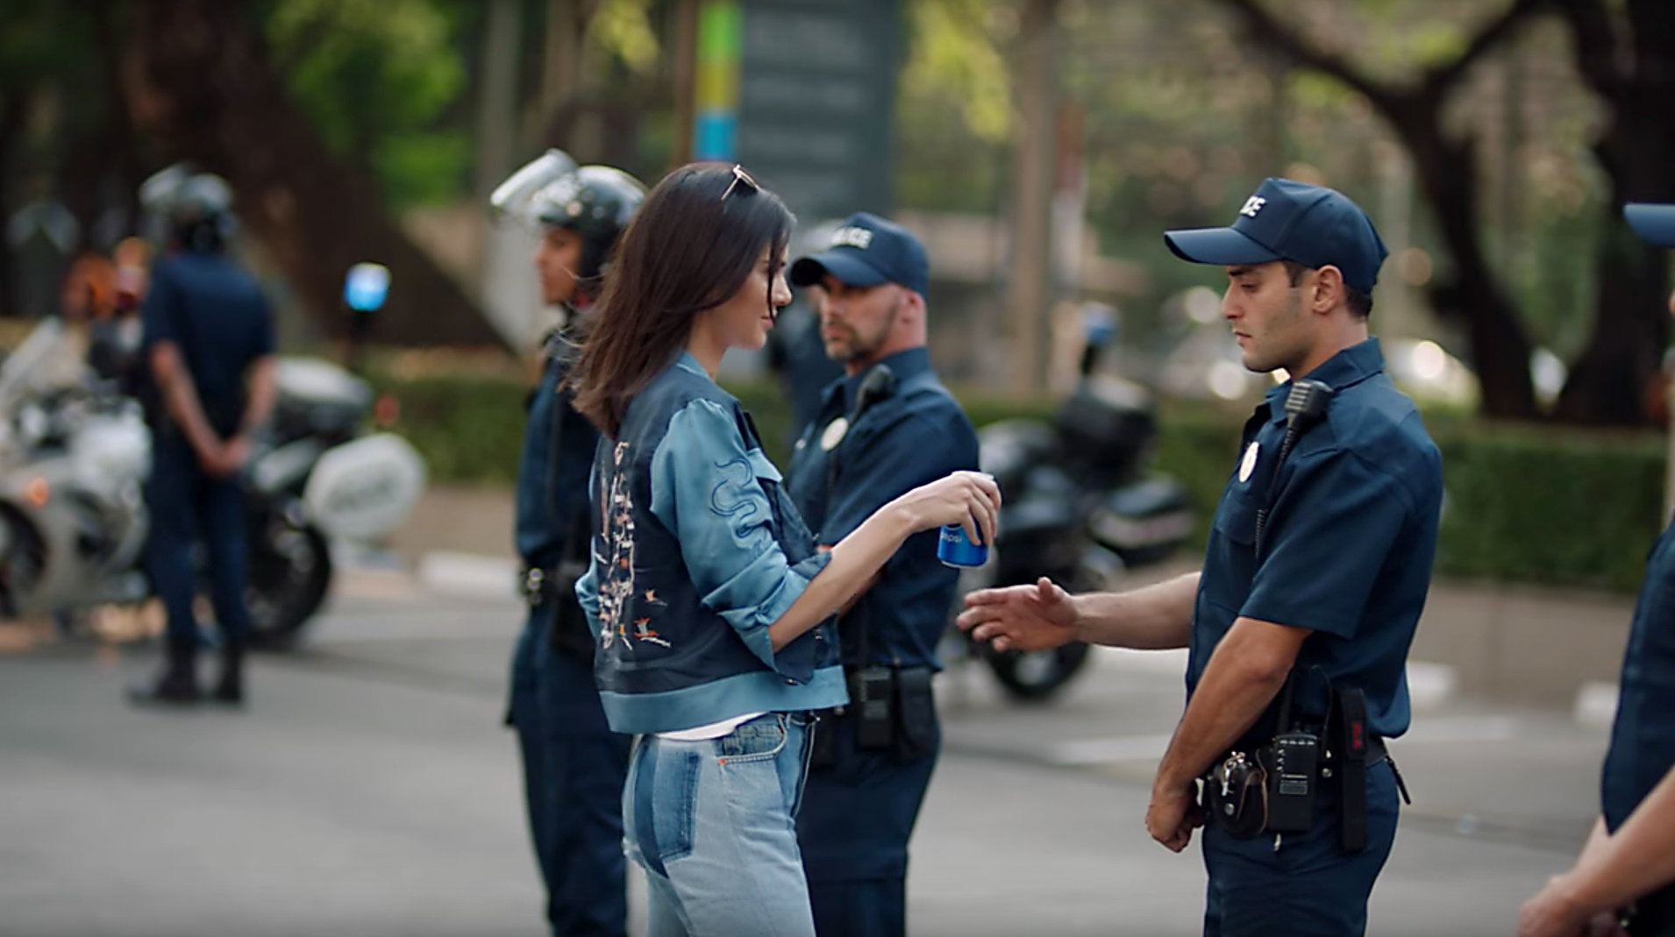
Stuart Halls Encoding Decoding Model
Encoding Text Decoding
Producers Assemble
signifiers and arrange
them to communicate
particular meanings. The intended
Meaning is the preferred meaning.
The carrier of the producer’s meaning.
Audience actively interprets the text, drawing on their own personal experiences to produce a particular reading of the text (i.e. to associate the signifiers with specific signifieds.
Three outcomes of decoding
Dominant reading = audience decodes meaning of the text in line with the producer’s intentions (viewer reproduces the “preferred meaning”
Oppositional reading = Audience rejects totally the social and political meanings and values “preferred” by the producer.
Negotiated reading = audience endorses some elements of the message, while rejecting other parts.

Slide 16
References
Al Mamun Khan, M. F. (2014). Semiotics: The Representation, Construction and Evaluation of Reality. Language in India, 14(8), 78–89.
Hall, S. (1985). Signification, representation, ideology: Althusser and the post‐structuralist debates.
Lang, K., & Lang, G. (2009). Mass Society, Mass Culture, and Mass Communication:The Meanings of Mass. International Journal Of Communication, 3, 20. Retrieved from https://ijoc.org/index.php/ijoc/article/view/597
Ouelette, L. (1997). Media Education Foundation study guide: Gerbner series. Media Education Foundation.

